Slide 1



Dashboard Line 2
Initialized 5/25/2016 7:03:15 PM
PLAN
1563
1638
ACTUAL
Goal Deployment to the Line
95%

Slide 2
6th S: Safety (Promote Safety)
1st S: Sort (Organization)
2nd S: Set (Orderliness)
A place for everything and everything in its place.
Assign permanent place for all needed items.
Choose proper storage methods.
Visually indicate locations.
Missing items easily noticed.
Utilize sign boards.
6S
5th S: Sustain (Way Of Life)
2nd S: Set (Orderliness)
4th S: Standardize (Set Standards)
Process for Maintaining the first 3 Ss.
Define procedures and activities to ensure that Sort, Set in Order and Shine practices are maintained and executed consistently.
Share and promote established standards.
4th S: Standardize (Set Standards)
3rd S: Shine (Clean & Inspect)
6th S: Safety (Promote Safety)
Building awareness into all activities to identify and eliminate hazards and injury or danger free workplace.
Accident Prevention
Follow Safety Rules
Improved employee morale
1st S: Sort (Organization)
Distinguish between what is needed and not needed. “Clear the Workplace” of everything unnecessary to the function being performed NOW!:
Touch everything.
Remove all that is not required.
Remove all the waste, by-products, empty containers, etc.
3rd S: Shine (Clean & Inspect)
Cleaning and looking for ways to keep it clean.
Eliminate dirt, dust, oil, scrap, etc.
Keep workplace swept & wiped down.
Clean in, under, and around equipment and furniture.
Integrate cleaning into everyday tasks.
Importantly, clean where the product flows.
5th S: Sustain (Way Of Life)
Practicing and repeating this discipline until it becomes a way of life.
Make it a habit, 6S should be a personal goal.
Set a good example!, Look and take action!
Should be voluntarily observed.
Maintain a favorable 6S atmosphere.
Both management and operations have the responsibility for sustaining 5S.

Slide 3
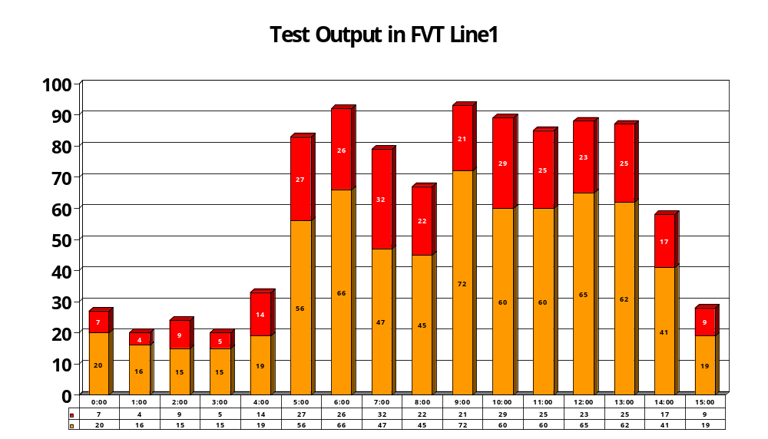

Slide 4
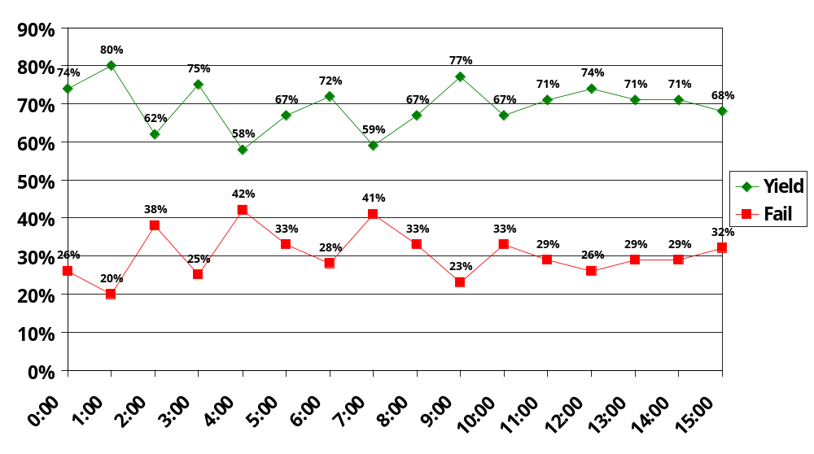

Slide 5
Rank | User ID | 0 | Workstation
 | 02221989 | 61 | ONTDS1C05
2 | 10261996 | 57 | ONTDS1C06
3 | 13277750 | 44 | ONTDS1C03
4 | 11128923 | 43 | ONTDS1C06
5 | 0030686 | 42 | ONTDS1C08
6 | 12898672 | 37 | ONTDS1C05
7 | 13371404 | 33 | ONTDS1C04
8 | 12172820 | 32 | ONTDS1C07
9 | 12221991 | 29 | ONTDS1C07

Slide 7
Configuration For Numbers Report Slide
Database Connection
Slide Configuration
DSN:
Viper
Refresh Rate (seconds):
10
Database:
dbServices
Green Numbers (%):
98
Username:
ViperDashboard
Yellow Numbers (%):
85
Password:
Dashb04rd
Note: Red Numbers are any percentage
below Yellow Numbers.
Stored Procedure
Stored Procedure:
EXEC ssrs06_procGetRptDTVScreeningTVsOperations_SubRpt1
Line:
LINE2
Operation:
PACK-OUT

Slide 8
Configuration For Daily Report Slide
Database Connection
Slide Configuration
DSN:
Viper
Refresh Rate (seconds):
10
Database:
dbServices
Username:
ViperDashboard
Password:
Dashb04rd
Stored Procedure
Stored Procedure:
EXEC procRptTestOutputAutomation
Operation:
LINE2
Line:
FVT

Slide 9
Configuration For Users Report Slide
Database Connection
Slide Configuration
DSN:
Viper
Refresh Rate (seconds):
10
Database:
dbServices
Username:
ViperDashboard
Password:
Dashb04rd
Stored Procedure
Stored Procedure:
EXEC procRptTestOutputAutomationUsers
Operation:
FVT
Line:
LINE1

